Slide 1







Accelerate Uptake, Use and Impact
Introductory Webinar 20/02/2025
(3-4 pm CEST)

Slide 2
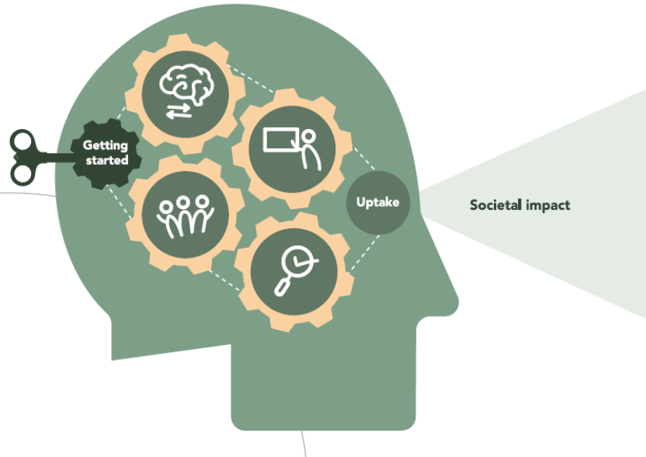
Agenda
Introduction of the core team
Overview of the UUI accelerate trajectory
Key activities of the inception phase
Different options to become involved
Q&A

Slide 3
1. Introduction of the core team

Slide 4








Introduction of the core team

Slide 5
2. Overview of the UUI trajectory

Slide 6
Vision & timeline
Support the VLIR-UOS community and relevant stakeholers across the VLIR-UOS portfolio to creat the conditions for uptake-use –impact of research and innovation insights.
Inception
Phase
Full start UUI project
Jan-Jun 2025
24 June
1 Sep
2025
31 Aug
2027
Submission Fully fledged proposal
End project

Slide 7
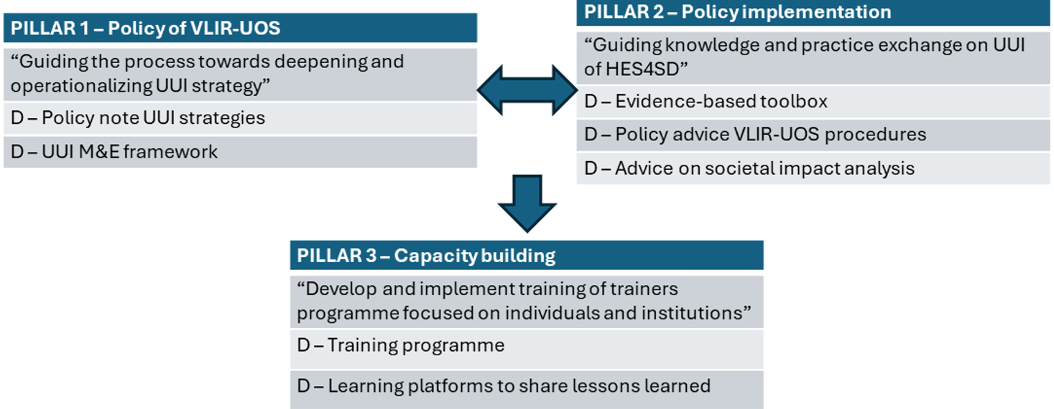
Expected outcomes

Slide 8
3. Key activities of the inception phase

Slide 9
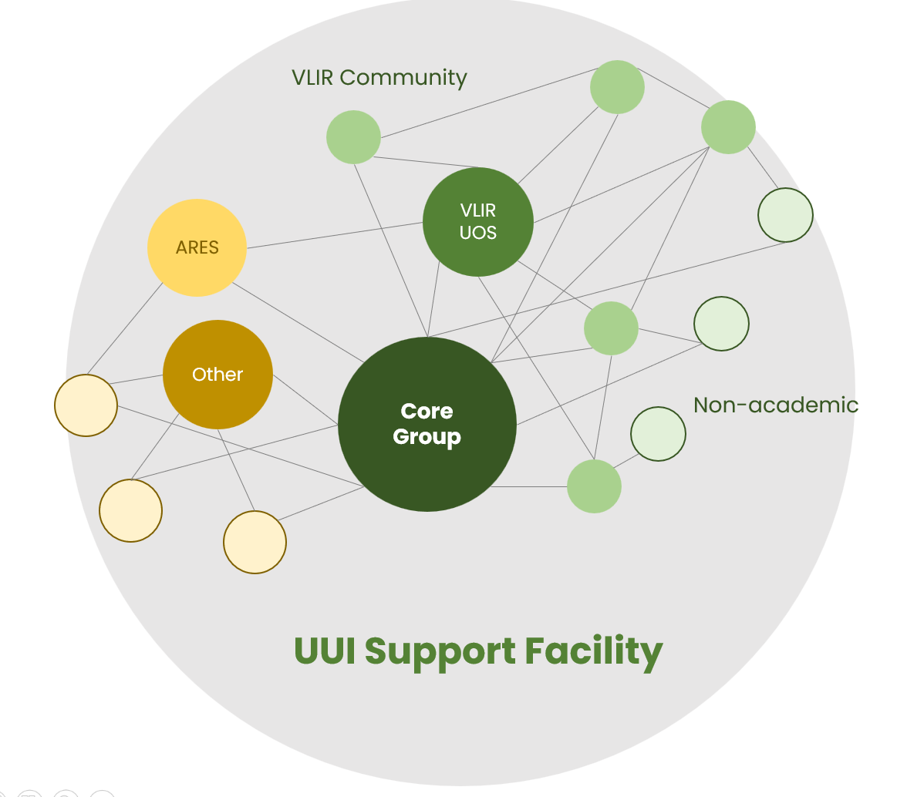
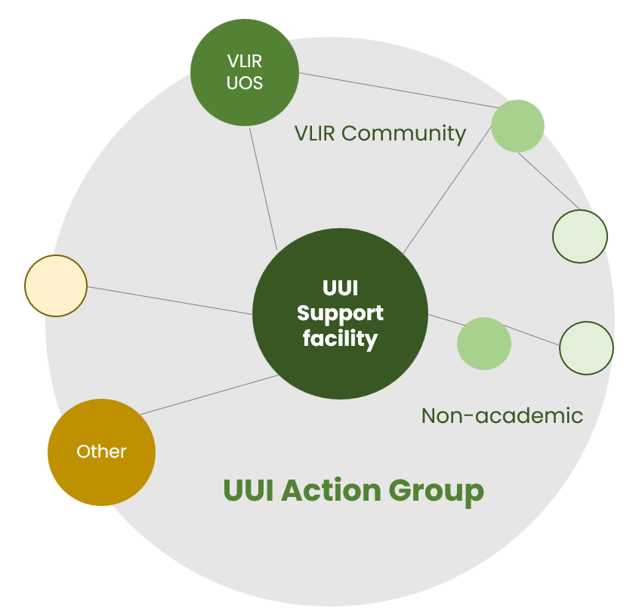
UUI ACTION LEARNING COMMUNITY
INCEPTION PHASE
IMPLEMENTATION PHASE
Pillar1: Policy of VLIR UOS
“Guiding the process towards deepening and operationalizing UUI strategy”
D1. Policy note UUI Strategies
D2. UUI M&E framework
forward
Consolidation broader consortium & proposal
Pillar2: Policy implementation
“Guiding knowledge and practice Exchange on UUI of HES4SD
D3. Evidence-based toolbox
D4. Policy advice VLIR UOS Procedures
D5. Advice on societal impact analysis
Actualisation UUI framework
Deep dive into VLIR UOS practices
UUI learning event
Experimentation and collaborative learning
CYCLIC PROCESS
FINAL PROPOSAL
feedback
Pillar3: Capacity building
“Develop and implement training of trainers programme focused on individuals institutions”
D6. Training programme
D7. Learning platforms to share lessons learned
Analysis existing information VLIR UOS
Reviewing Updated Literature
Expanding network
Co-creation
Follow-up on lessons learned
Interviews

Slide 10
Planning – inception phase
Activities | Dates
Kick off meeting core group | 07/01/2025
Actualisation UUI conceptual framework
Desk review | January
Deep dive into VLIR-UOS UUI practices
Sampling, interviews, consultations | February - March
Feedback to broader VLIR UOS community and other stakeholders
Send out information about the UUI track via VLIR UOS channels and core group contacts | January - Feb
Online webinar providing info about the UUI track and progress sofar | 20/02/2025
Online learning event
Preparation for online learning event (programme, invitations,…) | March-April
Organisation of the event (2 half days) | 28 and 29/04/2025 (3-5 pm GMT)
Development of full proposal | May – June
Submission of full proposal | 24 June

Slide 11

Some first reflections/findings on UUI practice
Need to integrate UUI strategies into the project design stage.
Various UUI frameworks…. need for integration?
Need to develop insights in how actions contribute to impact/causal mechanisms
Different toolsets are available for facilitating uptake and use
Need for good UUI practices/UUI succes stories
Importance of active stakeholder participation
How to further align VLIR-UOS monitoring system with Agenda 2030?
Need for more stable set of standard indicators over time?
How to balance planning/reporting requirements with adaptive project management?

Slide 12
4. Different options to become involved

Slide 13

Different options to become involved
As a member of the broader UUI consortium
  Become part of a pool of UUI experts who can be called upon to provide support to the learning community.
  Learning event of 28 & 29 March as first opportunity ☺
As an active member of the UUI action group
  Bring your VLIR-UOS project as a case study in the UUI action group
As a participant to learning events of the broader UUI learning community
By taking part in discussions of the online UUI discussion forum

Slide 14
5. Q&A

